Slide 1
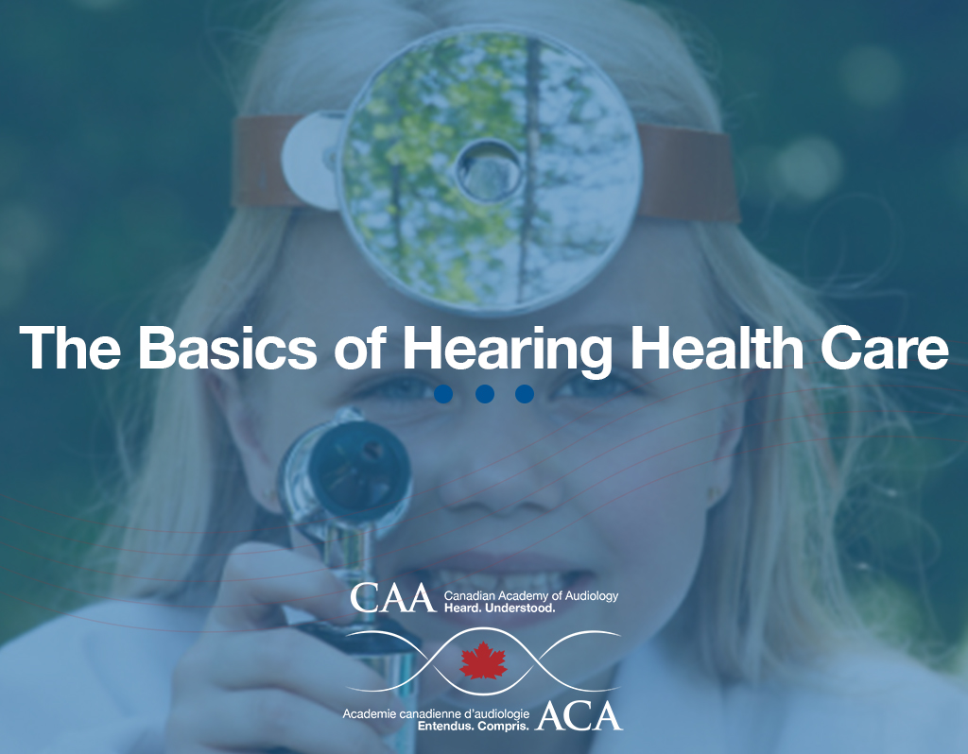

Slide 2
Outline
Impact of Hearing Loss
What is an Audiologist?
  i. Definition
  ii. Audiology Scope of practice
Audiology 101
Common “ear-related” complaints and Types of Hearing Loss
  i. What is included in a typical Audiological Assessment
  ii. Deciphering an Audiogram
  iii. Hearing aids
How can we help you and your patients?
  i. Audiology Scope of practice
  ii. The Importance of Audiologic Treatment and Assessment

Slide 3
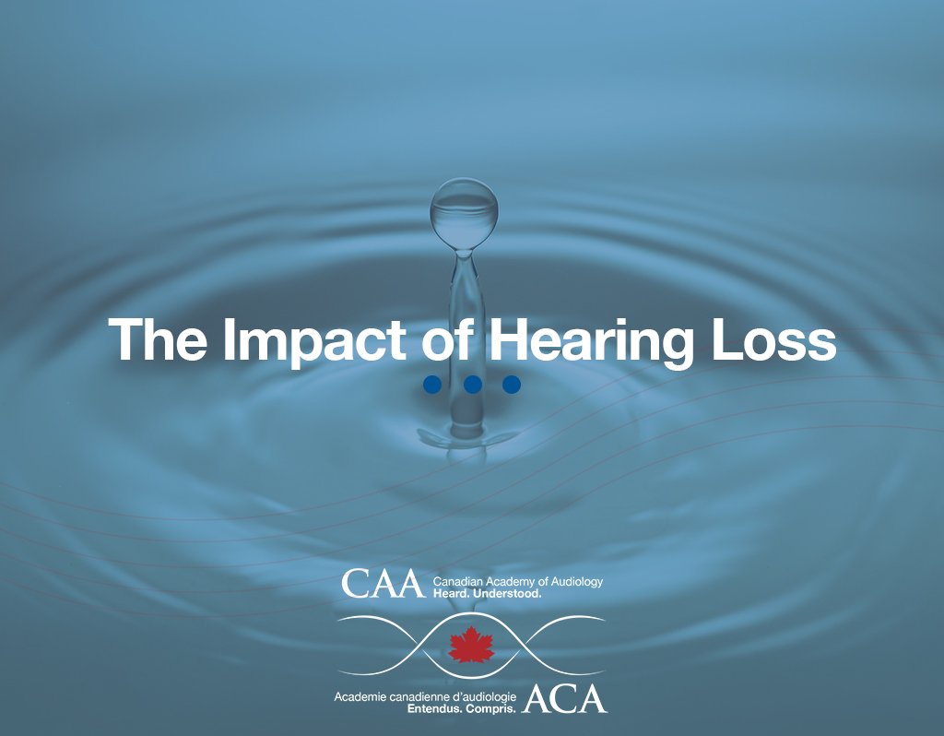

Slide 4
Impact
Hearing loss
Is the second most prevalent cause of living with a disability after depression [Mathers et al (2003) and Weinstein (2011)]
Is recognized by the World Health Organization as being in the top 3 of their Global Burden of Disease along with depression and arthritis (http://www.who.int/mediacentre/factsheets)
Can accelerate some disabilities such as cognitive dysfunction and depression
Can be mistaken for cognitive concerns

Slide 5
Statistics
1 in 5 Canadians aged 20 to 79 (an estimated 4.6 million adults) have hearing loss.
  Aging is the leading cause of hearing loss (Cruickshanks et al. 2003), with measured hearing loss rising sharply after age 40, to reach 44% at ages 60-69, 65% at ages 70 to 79 and 90% over the age of 80 (Cruickshanks et al. 1998) .
The population aged 65 + is projected to double from 5 million in 2011 to 10.4 million by 2036.
http://www.statcan.gc.ca/pub/82-003-x/2015007/article/14206-eng.htm

Slide 6
Impact
Hearing loss can lead to:
An increased risk of poverty (Jung et al. 2012)
Social isolation (Arlinger, 2003)
Increased need for support services and hospital care (Schneider, 2010)
Depression, withdrawal, stress, anger and fatigue causing damage to families and relationships (Chia, 2007); (Sindhusake, 2001)

Slide 7
Impact
In summary, the impact of hearing loss includes:
Restricted quality of life
Increased cost to healthcare systems
Increased dependence on social services
Lost contributions to the economy and to communities
Hearing loss can be managed to reduce the impact

Slide 8
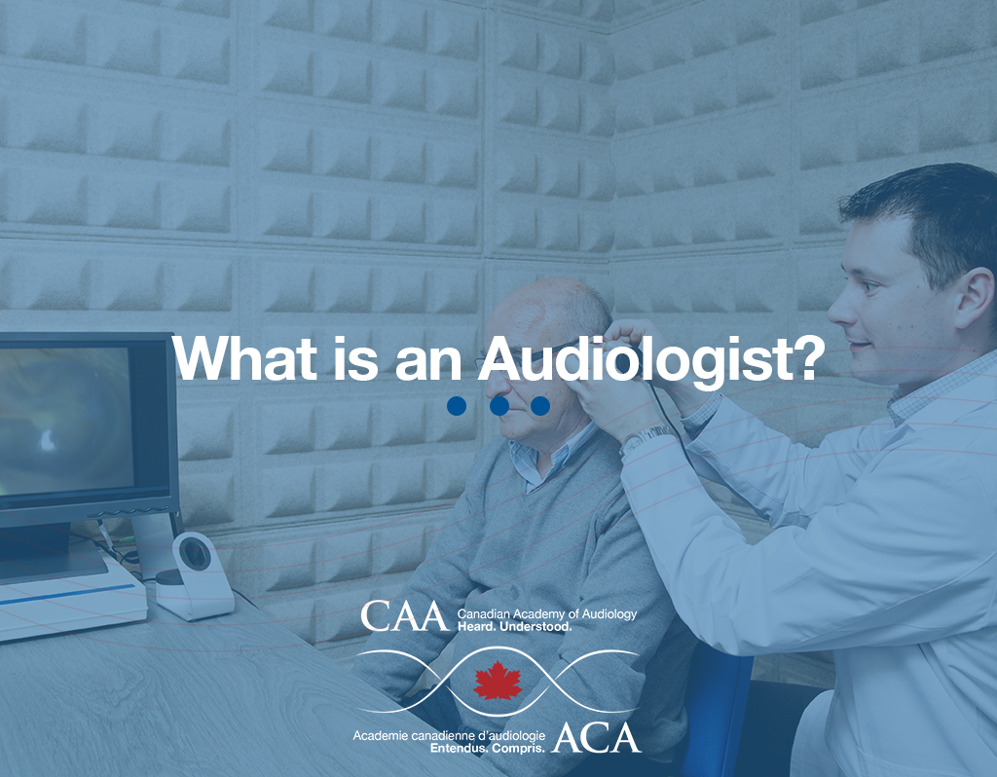

Slide 9
What is an Audiologist?
An audiologist is an independent, professional provider of primary hearing health care, who specializes in the conservation of hearing and in the identification, assessment, management, and treatment of hearing and balance disorders.
https://canadianaudiology.ca/professional-resources/scope-of-practice/

Slide 10
What is an Audiologist?
Audiologists hold a master’s or doctoral degree in audiology from an accredited university, and are,
in most provinces, licensed or otherwise
governed by a regulatory body.
Audiologists serve in a number of roles including clinician, diagnostician, therapist, educator, consultant, researcher, and administrator.
https://canadianaudiology.ca/professional-resources/scope-of-practice/

Slide 11
Scope of Practice
Identification
Treatment
Counselling
Cerumen management
Educational consulting
Vestibular Assessment and Rehabilitation
Newborn Hearing Screening programs
Involvement in auditory implant teams
Coordinate hearing conservation programs
Intraoperative Monitoring
Advocacy
Research
https://canadianaudiology.ca/professional-resources/scope-of-practice/

Slide 12
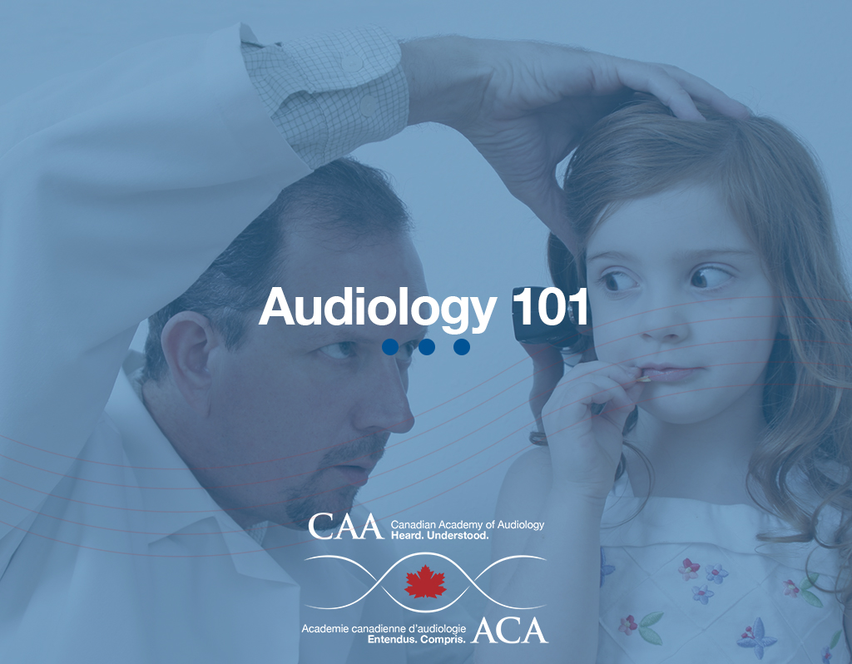

Slide 13
Audiology 101: Outline
Common ear-related complaints
Hearing Loss and Children
What is an Audiological Assessment?
Deciphering an Audiogram
Types of Hearing Loss
Amplification
(Re)Habilitation

Slide 14
Common Ear Related Complaints
Trouble hearing in noise
“Sounds are muffled”
“Everyone mumbles”
Difficulty hearing on the phone…
Ringing, whooshing or buzzing sound
Balance concerns
Pain in the ear (Otitis media)
Itchy ear canals (External otitis, fungal growth)

Slide 15
Audiological Assessment
Audiological Test | Clinical Application
Otoscopy | Confirms (un)occlusion of ear canal
Tympanometry | Confirms presence of middle ear fluid Checks overall mobility of middle ear system
Acoustic Reflexes | Confirms integrity of auditory and facial nerve pathways Can detect presence of a retrocochlear lesion
Otoacoustic Emissions | Checks outer hair cell integrity Confirms sensorineural hearing loss
Pure Tone Testing | Checks entire behavioral auditory system Confirms presence or absence hearing loss Confirms type and degree of hearing loss
Speech Reception Threshold | Determines lowest level of perceptible speech Confirms presence of hearing loss
Word Recognition | Measures accuracy level of perceived speech Determines potential candidacy for hearing aids
Speech in Noise Testing | Indicates difficulty understanding speech in noise Predictive of hearing aid benefit
Specialized Evoked Potentials | Measures cortical response to auditory stimuli

Slide 16
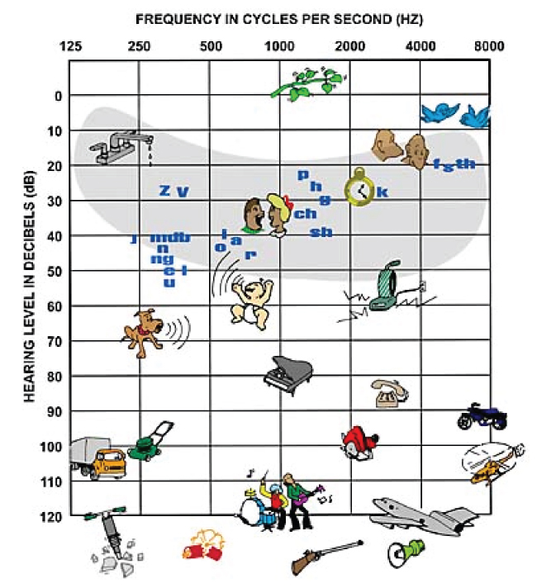
Deciphering an Audiogram

Slide 17
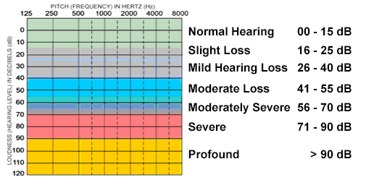
Degree of Hearing Loss
Hearing loss is described in degree, shape and nature, not in percentages…

Slide 18
Types of Hearing Loss
Conductive Hearing Loss: caused by an abnormality of the conductive system.
Pathology of the EXTERNAL EAR
External ear canal deformity (atresia)
Blockage from cerumen or foreign object
Perforated tympanic membrane
Pathology in the MIDDLE EAR
Serous and Purulent Otitis media
Otosclerosis
Cholesteatoma
  Treatment may include ongoing monitoring, amplification with hearing aids or Bone Anchored/Conduction
  Hearing Devices

Slide 19
Types of Hearing Loss
Sensorineural Hearing Loss: caused by hair cell damage or abnormality within the cochlea (inner ear).
Noise exposure
Ototoxic medication
Meniere’s disease
Infections
Idiopathic
Congenital
Aging (presbycusis)

Slide 20
Types of Hearing Loss
Mixed Hearing Loss: Hearing loss due to both conductive and
sensorineural factors

Slide 21
Types of Hearing Loss
Retro-cochlear Pathology: Hearing loss due to a misconnection
between the inner ear and auditory centre of the brain.
Disorders include:
Auditory Neuropathy
Central Auditory Processing Disorder
Acoustic Neuroma

Slide 22
What Does Untreated Hearing Loss Look Like?
Common coping strategies used by individuals with untreated
hearing impairment include:
  Substitution: “mall or Paul?”
  Smile and nod…
  Talking and not listening
  “What? Huh?”
  Withdrawal: social and environmental
  Speaking loudly
Such coping strategies often lead to miscommunication, indifference, exhaustion, social isolation and frustration.
They can also easily be mistaken for cognitive impairment.

Slide 23
Hearing Loss in Children
Effects of Untreated Hearing Loss on a Child's Development:
Development delays in both receptive and expressive communication skills (speech and language). These skills are critical for meeting developmental milestones and allowing children to interact with those around them.
Learning challenges that result in reduced academic achievement.
Communication difficulties often lead to social isolation and poor self-concept.
May have an impact on vocational choices.
UNTREATED HEARING LOSS IN CHILDREN OFTEN PRESENTS AS MISIDENTIFIED BEHAVIOURAL CONCERNS.
http://www.asha.org/public/hearing/Effects-of-Hearing-Loss-on-Development/

Slide 24
Hearing Loss in Children
Some common issues youth with hearing loss face are:
1) Identity confusion. Youth with hearing loss may have a hard time understanding where they fit in with peers, especially if they are exposed only to hearing peers. They may ask themselves: “Am I Deaf? Hearing? Or in between…If so, what does that mean?”… or “Am I the only one?”
2) Academic challenges. Students with hearing loss may fall behind in school because they can miss information and disengage from class discussions. The hearing loss makes it difficult to take notes and listen at the same time, or catch every bit of cross talk, so students have to work extra hard to keep up.
3) Depression or low self- esteem. Again, this is a common experience for many teens, but some youth with hearing loss might feel frustrated by the sense of being ‘different.’ This can lead to social isolation, withdrawal and other symptoms of depression.
http://www.hearingspeech.org/main/care-treatment/concerns/hearing-loss-effects-on-child-development/

Slide 25
Amplification
Digital hearing aids contain sophisticated sound processing software algorithms that tailor the response to the individual patient’s needs
Bilateral amplification is recommended to help improve communication in noise and sound localization ability
Consistent use is key, as is providing intervention sooner rather than later
90% of people with hearing loss can improve communication with properly fitted hearing aids and rehabilitative counselling [McArdle R et al. (2005), Boothroyd (2007), Hawkins (2005)]
Assistive Listening Devices: Pocket Talkers, remote microphones, amplified telephones and FM systems
Implantable devices: Cochlear Implants, Bone Anchored Hearing Devices and Middle Ear Drivers

Slide 26
Benefits of Amplification
After recording significant improvements in the psychological state and mental functions of a population of hearing aid users age 65 +, Acar et al. (2011) concluded that using hearing aids are a good solution for the elderly.
Hearing aids improve adults’ health-related quality of life by reducing the psychological, social, and emotional effects of hearing loss. (Chisolm, T et al. 2007)

Slide 27
Consequences of Hearing Loss
Hearing is the most SOCIAL SENSE we have.
Without it, we are isolated
Frustration
Withdrawal
Isolation
Depression
Long term care

Slide 28
Dementia and Hearing Loss
  30% to 40% of people with hearing loss are at greater risk of experiencing cognitive decline as compared to those who have normal hearing.
  (Lin et al. 2013)
  Why?
    A reduction in neural stimulation (neuron firing)
    Loss of environmental stimulation
    Poor social interactions, loneliness (isolation?)
    Exhaustion due to increased effort to hear
It is important for hearing-impaired adults both with and without cognitive decline and or functional deficits to receive the appropriate audiologic treatment to improve their quality of life.

Slide 29
Hearing Loss and Depression
Studies demonstrating links between hearing loss and depression found that:
Individuals with hearing loss are more vulnerable to depression (Castiglione, 2016)
Individuals with hearing loss often display maladaptive coping skills (Manrique-Huarte, 2016)
Individuals with hearing loss can have symptoms of anxiety and depression (Hsu, 2016)
Clinical Implications: An untreated hearing loss may be a contributing factor to a persons’ depression.

Slide 30
Hearing Loss and Depression
The use of hearing aids leads to significantly fewer depressive symptoms and significantly improved
quality of life, general health, mental health, social engagement and emotional stability.
Boi et al (2012) , Mulrow et al (1990)
It is important for hearing-impaired adults both with and without cognitive decline and or functional deficits to receive the appropriate audiologic treatment to improve their quality of life.

Slide 31
Hearing Loss and Other Co-Morbid Conditions
Hearing loss has now been linked to a broad range of disease processes including:
An association between high frequency hearing loss and increased risk of falls. Lin and Ferrucci (2012)
An association with Type II diabetes:
hearing impaired adults are more than twice as likely to have Type II diabetes compared to those who do not have hearing loss. Bainbridge et al (2008)
A link with cardiovascular disease. Gates et al (1993) and Fisher et al (2014)

Slide 32
Hearing Loss and Other Co-Morbid Conditions
Clinical implications:
In summary, hearing loss is often linked to other chronic medical conditions such as:
  Falls
  Type II Diabetes
  Cardiovascular disturbances
  Cognitive decline
  Depression
Hearing loss can be a hidden disability!
Regular hearing tests/rehabilitation should be done to promote long-term health and longevity.

Slide 33
Patients With Hearing Loss
Hearing loss interferes with a patient’s ability to be treated for other medical conditions as it can hinder their ability to engage with physicians and understand treatment advice and directives.
Aspects of patient-physician communication affected by hearing loss include:
  Review of medication use, dosage, etc.
  Cognitive assessment (dementia or other cognitive deficits)
  Cognitive or depression screenings
  Communication of key components of a treatment plan or follow-up care
  Discussion of palliative care and end of life issues

Slide 34
Why Refer an Audiologist?
As university trained professionals, audiologists have a broader range of testing, diagnostic and management skills than college educated hearing care providers.
An audiologist can provide hearing health care to people of all ages, including children and infants.
Audiologists have a strong partnership with ENT surgeons for care and adaptation after intervention is selected.
Testing is non-invasive and only takes 30-45 minutes.
Amplification and proper counselling/rehabilitation services have been proven to alleviate the negative effects of untreated hearing loss.

Slide 35
Summary
Hearing impairment is a hidden disability not
often perceived by patients or those within
their support system.
Hearing loss is often linked to other
chronic medical conditions.
Encourage your patients to have their hearing tested as part of their annual check-up,
especially if they are over the age of 60.

Slide 36
REFERENCES
Acar, B et al. (2011) Effects of hearing aids on cognitive functions and depressive signs in elderly people. Archives of Gerontology and Geriatrics. 52(3):250-252
Aging in the Community – Ontario Health Technology Assessment Series 2008;8(1)
Allen, N.H., Burns, A., Newton, V., Hickson, F., Ramsden, R., Rogers, J. et al., (2003) The effects of improving hearing in dementia. Age Ageing, 32, 189-193.
Arlinger, S. (2003) Negative consequences of untreated hearing loss: A review. International Journal of Audiology, 42, 2S17-21.
Bainbridge, et al. (2008). Diabetes and hearing impairment in the United States (NHANES). Annals Intern Med. 149(1): 1-10.
Boi R, Racca L, Cavallero A, Carpaneto V, Racca M, Dall'Acqua F, Ricchetti M, Santelli A, and Odetti P. (2012). Hearing loss and depressive symptoms in elderly patients. Geriatr Gerontol Int. 12(3):440-5.
Boothroyd A. (2007) Adult aural rehabilitation: what is it and does it work? Trends Amplif; 11(2): 63-71
Castiglione A, Benatti A, Velardita C, Favaro D, Padoan E, Severi D, Pagliaro M, Bovo R, Vallesi A, Gabelli C, Martini A (2016). Aging, Cognitive Decline and Hearing Loss: Effects of Auditory Rehabilitation and Training with Hearing Aids and Cochlear Implants on Cognitive Function and Depression among Older Adults. Audiol Neurootol. 2016;21 Suppl 1:21-28.
Chia EM, Wang JJ, Rochtchina E, Cumming RR, Newall P, Mitchell P. (2007) Hearing impairment and health related quality of life: the Blue Mountains Hearing Study. Ear Hear 28(2) 187-95;

Slide 37
REFERENCES
Chisolm, Theresa Hnath; Johnson, Carole E.; Danhauer, Jeffrey L.; Portz, Laural J. P.; Abrams, Harvey B.; Lesner, Sharon; McCarthy, Patricia A.; Newman, Craig W. (2007) ort of the American Academy of Audiology Task Force on the health-related quality of life benefits of amplification in adults. Journal of the American Academy of Audiology, Vol 18(2), Feb, pp. 151-183. Publisher: American Academy of Audiology.
Cruickshanks KJ et al. (1998) Prevalence of hearing Loss in older adults in Beaver Dam, Wisconsin. The Epidemiology of Hearing Loss Study. Am J Epidemiol 148 (9).
Cruickshanks KJ, Tweed TS, Wiley TL, Klein BE, Klein R, Chappell R, Nondahl DM, Dalton DS. (2003) The 5-year incidence and progression of hearing loss: the epidemiology of hearing loss study. Arch Otolaryngol Head Neck Surg 129(10): 1041-6)
Fisher, et al. (2014). Impairments in hearing and vision impact on mortabiity in older people. Age and Aging. 43(1): 69-76.
Garnefski N and Kraaij V. (2012). Cognitive coping and goal adjustment are associated with symptoms of depression and anxiety in people with acquired hearing loss. Inter Jour Aud. 51(1): 545-550.
Gates GA, Cobb JL, D'Agostino RB, and Wolf PA. (1993). The relation of hearing in the elderly to the presence of cardiovascular disease and cardiovascular risk factors. Arch Otolaryngol Head Neck Surg. 119(2):156-161.

Slide 38
REFERENCES
Hawkins DB. (2005) Effectiveness of counseling-based adult group aural rehabilitation programs: a systematic review of the evidence. J Am Acad Audiol 16(7): 485-93
Hsu WT, Hsu CC, Wen MH, Lin HC, Tsai HT, Su P, Sun CT, Lin CL, Hsu CY, Chang KH, Hsu YC (2016). Increased risk of depression in patients with acquired sensory hearing loss: A 12-year follow-up study. Medicine (Baltimore). 2016 Nov;95(44):e5312.
Jones E and White A. (1990). Mental health and acquired hearing impairment: A review. Brit Jour Aud. 24(1): 3-9.
Jung, David & Bhattacharyya, Neil, (2012) Association of Hearing Loss With Decreased Employment and Income Among Adults in the United States. Annals of Otology, Rhinology & Laryngology, Dec; 121 (12): 771-5
Lin F, Ferrucci L. (2012). Hearing loss and falls among older adults in the United States. Arch Intern Med. 172(4): 369-371.
Lin F, et al. (2013). Hearing loss and cognitive decline in older adults. JAMA Intern Med. 173(4)293-299.
Manrique-Huarte R, Calavia D, Huarte Irujo A, Girón L, Manrique-Rodríguez M (2016). Treatment for Hearing Loss among the Elderly: Auditory Outcomes and Impact on Quality of Life. Audiol Neurootol. 2016;21 Suppl 1:29-35.
Mathers C, et al. (2003). Global burden of hearing loss in the year 2000. Geneva: World Health Organization. www.who.int/healthcareinfo/statistics/bod_hearingloss.pdf [accessed July 18, 2015].
McArdle R, Chisolm TH, Abrams HB, Wilson RH, Doyle PJ (2005). The WHO-DAS II: Measuring Outcomes of Hearing Aid Intervention for Adults. Trends Amplification Summer 2005, 9(3): 127–143.

Slide 39
REFERENCES
Medical Advisory Secretariat. Aging in the community: summary of evidence based analysis [Internet]. [updated 2008; cited 2009 Feb 1]. Available from: http://www.health.gov.on.ca/english/providers/program/mas/tech/reviews/pdf/rev_ac_sum_20081002.pdf
Mulrow CD, Aguilar C, Endicott JE, Tuley MR, Velez R, Charlip WS, Rhodes MC, Hill JA, and DeNino LA. (1990). Quality-of-life changes and hearing impairment: A randomized trial. Ann Intern Med. 13(3):188-194.
Peters, C.A., Potter, J.F., & Scholer, S.G. (1988) Hearing impairment as a predictor of cognitive decline in dementia. Journal of the American Geriatric Society, 36, 981-986
Quaranta, N., et al. (2014) The prevalence of peripheral and central hearingimpairment and its relation to cognition in older adults. Audiology & Neuro Otology, 19(1): p. 10-4.
Schneider J, Gopinath B, Karpa MJ, McMahon CM, Rochtchina E, Leeder SR, Mitchell P (2010). Hearing loss impacts on the use of community and informal supports. Age Ageing. 2010 Jul;39(4):458-64.
Sindhusake D, Mitchell P, Smith W, Golding M, Newall P, Hartley D. (2001). Validation of self-reported hearing loss. The Blue Mountains Study. Int J Epidemiol 30 (6) 1371-8.
Wahl, H.-W., & Heyl, V. (2003) Connections between vision, hearing, and cognitive function in old age. Generations, 27, 39-45.
Weinstein B. (2011). Screening for otological functional impairments in the elderly: Whose job is it anyways? Audiology Research. 1(12): 42-48.
Weinstein, B., & Amsel, L. (1986) Hearing loss and senile dementia in the institutionalized elderly. Clinical Gerontologist, 4, 3-15

