Slide 1

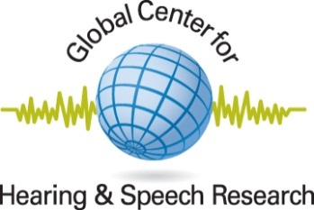
Biological Bases of Hearing Loss:
Hormonal & Pharmacological Prevention Strategies
Robert Frisina, Ph.D.
Professor and Director
Global Center for Hearing & Speech Research
Department of Chemical & Biomedical Engineering
Department of Communication Sciences & Disorders
University of South Florida- Tampa

Slide 2
Global Center for Hearing and Speech Research:
Summary of Key Multidisciplinary Studies
Summary: Hearing loss in our elderly population - Presbycusis
Accelerated by environmental, genetic, hormonal and biological etiologies.
Presbycusis can affect the ear (peripheral hearing loss) or
parts of the brain used for hearing
direct or indirect
Lines of research bearing upon this:
- Studies of humans with relatively good hearing thresholds have significant temporal processing and speech perception problems relative to young adults.
Starts in middle age in humans, & animals
Animal model findings:
Multidisciplinary, including behavioral measurements, neurophysiology, anatomical changes, & molecular genetic changes in the ear & brain with age.
Perception of speech and complex sounds in cortical centers
Brainstem
Auditory
System
Central
Impairment
Peripherally - Induced Central Changes
Insult-Age
Peripheral
Auditory
System
Peripheral Hearing Loss

Slide 3
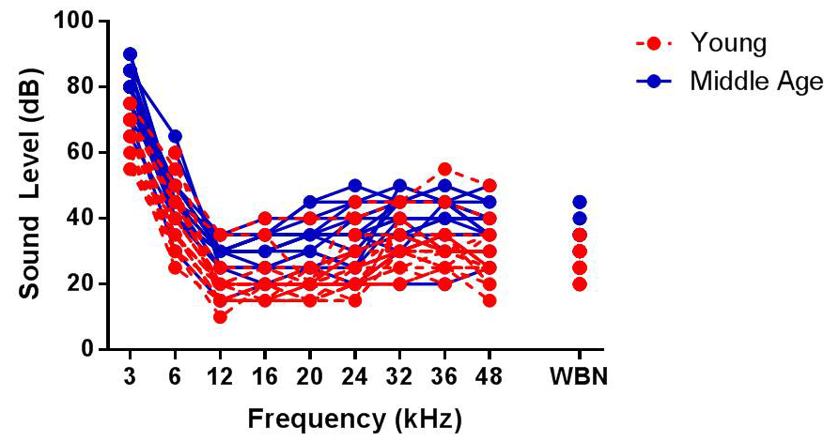
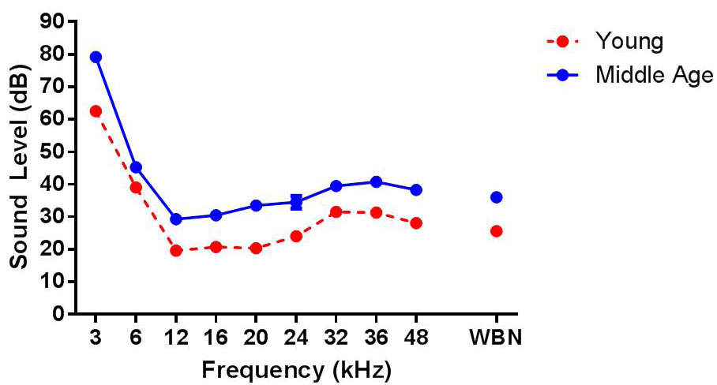
Gap-in-Noise ABR Responses- Middle age CBA Mice- Absolute Sensitivity
ABR threshold functions for Young adult and Middle age CBA mice- Good sensitivity
Presentation level for Gap-in-noise stimuli
Williamson, Frisina et al.,
- 2014

Slide 4
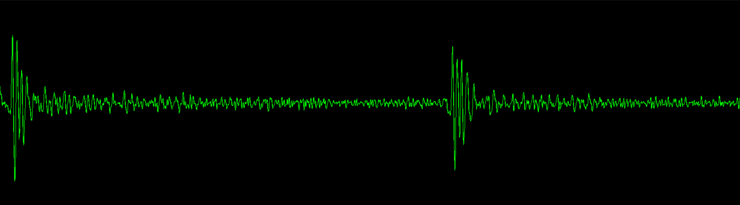
Gap-in-Noise ABR Responses- Decline in Middle age CBA Mice
Peak 1
Peak 4
NB1
NB2
0
30
60
90
120
150
Time (msec)
Amplitude and latency of the Peak/trough response to NB1 & NB2 are analyzed as a function of gap duration
Williamson, Frisina et al.,
- 2014

Slide 5
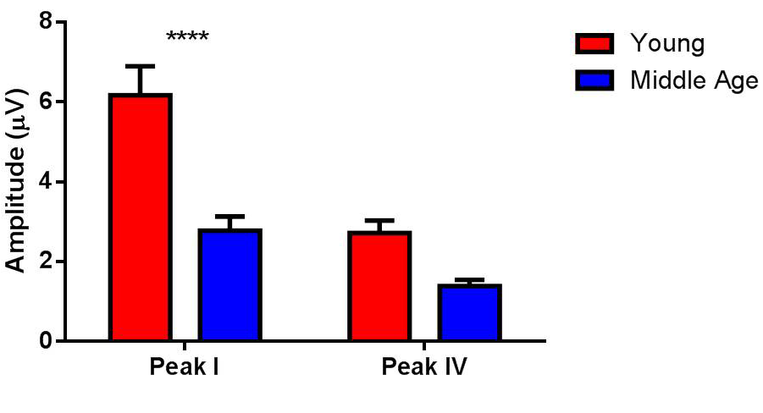
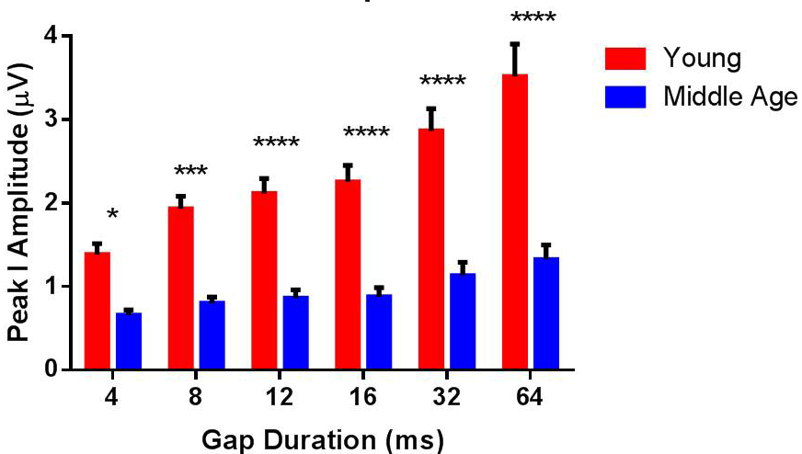
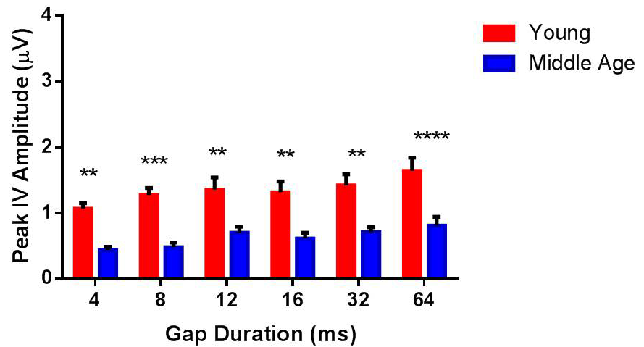
Gap-in-Noise ABR Responses- Young adult & Middle age CBA Mice
NB1
NB2
Amplitude of the response to NB1 & NB2 at 80 dB SPL: Increases with gap duration; Declines with age
Williamson, Frisina et al.,
- 2014

Slide 6
Hormones & Hearing: Preview Summary
Perspective – Why study?
Dennis Trune: Aldosterone can reduce autoimmune hearing loss in an animal model
Low aldosterone levels are linked to accelerated age-related hearing loss
Hormone Replacement Therapy – HRT – can decrease hearing in otherwise healthy, post-menopausal women
These alterations can occur in both the peripheral and central auditory systems
Analogous experiments in aging mice show similar disruptions or enhancements of hearing

Slide 7
Hearing in Animal Models:
Otoacoustic Emissions Decline with Age – Males faster than Females
CBA - Middle Frequencies (13 - 25 kHz)
30
25
Male
20
Female
15
10
DPOAE Amplitude (dB SPL)
5
0
-5
-10
-15
-20
Young
Middle-aged
Old
Age
From Guimaraes, Frisina et al., Hearing Res. 192, 2004

Slide 8
Nature of Hearing Deficits in Aged Listeners Taking HRT: Largest Clinical Study
Investigated aged women taking HRT, relative to Controls who were matched for age, sex and health history, 60 years old and above
N=32 E+P, N=30 E, N=62 Controls
Performed audiometric and otoacoustic emissions tests of the periphery, and experimental tests that tap brain function
Audiograms, otoacoustic emissions, HINT test
Found evidence for accelerated peripheral and central presbycusis

Slide 9
Progesterone Negatively Affects Hearing in Aged Women – Inner Ear Hearing Loss
E – Estrogen; P – Progestin; NHRT – Control Subjects, no history of HRT use
From Guimaraes, Frisina et al., Proc. Nat. Acad. Sci. – PNAS-USA, 2006

Slide 10
Progesterone Negatively Affects Hearing in Aged Women – Inner Ear
E – Estrogen; P – Progestin; NHRT – Control Subjects, no history of HRT use
From Guimaraes, Frisina et al., Proc. Nat. Acad. Sci. – PNAS-USA, 2006

Slide 11
Progesterone Negatively Affects Hearing in Aged Women - Brain
E – Estrogen; P – Progestin; NHRT – Control Subjects, no history of HRT use
From Guimaraes, Frisina et al., Proc. Nat. Acad. Sci. – PNAS-USA, 2006

Slide 12
Summary – HRT - Clinical
Pure tone audiometry: the E+P group had higher thresholds than the E group and NHRT group, for all frequencies
The E+P group presented lower DPOAE amplitudes than the E group and NHRT group for both ears
For HINT, the E+P group performed poorer than the E group and NHRT group across all background noise speaker locations
These findings suggest that the presence of Progesterone as a component of HRT causes poorer hearing abilities in aged women
Affecting both the peripheral and central auditory systems

Slide 13
Nature of Hearing Deficits in Aging Female Mice taking HRT
Investigated middle age Female CBA mice, relative to Controls who were matched for age
Implanted 2 X 60 day HRT pellet subcutaneously
N=12 mice in each group, longitudinal
Performed hearing tests of the periphery
ABR audiograms, otoacoustic emissions
Found evidence for accelerated peripheral auditory processing problem – including outer hair cell system

Slide 14
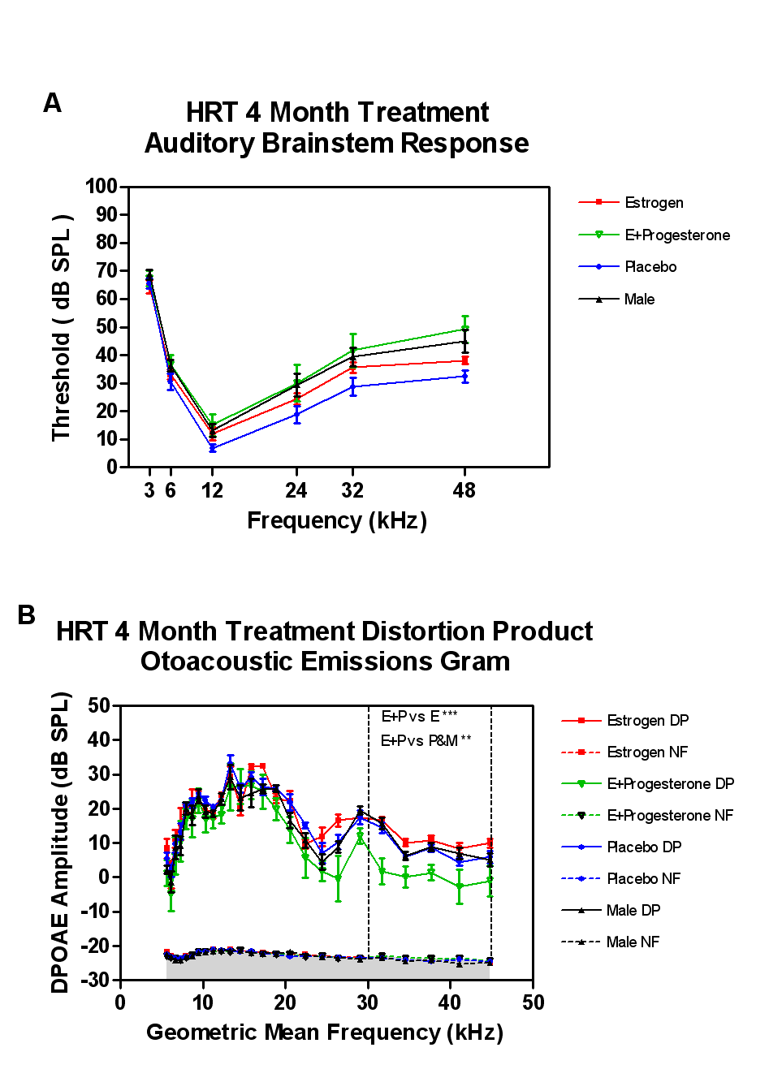
HRT Affects the Inner Ear in Aging Female CBA Mice:
HRT Elevates ABR Thresholds, Lowers DPOAE amplitudes
From Price, Frisina et al., Hear. Res, 252, 2009

Slide 15
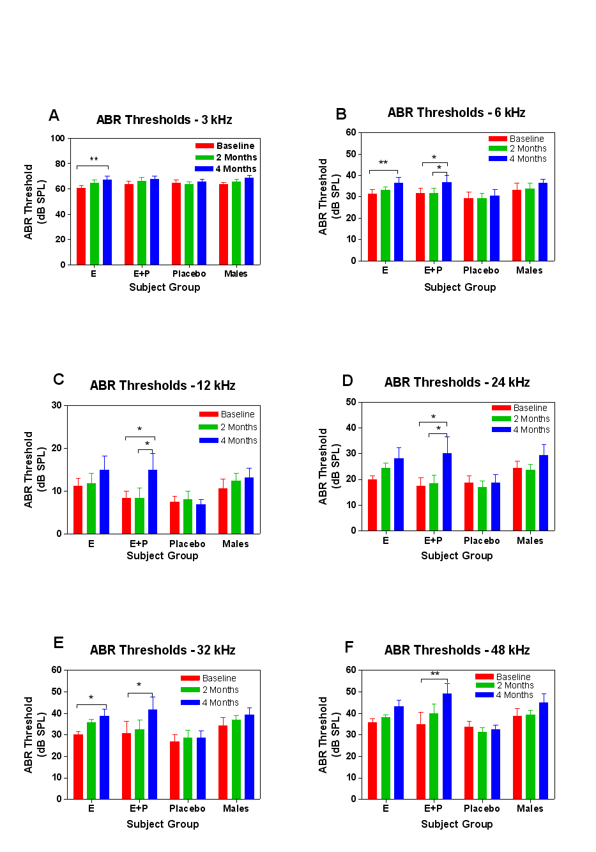
HRT Affects Cochlear Outputs in Aging Female CBA Mice
ABR Thresholds Elevate during HRT Treatments:
Progestin/Estrogen show the greatest impairment over 4 months of treatments
From Price, Frisina et al., Hear. Res, 252, 2009

Slide 16
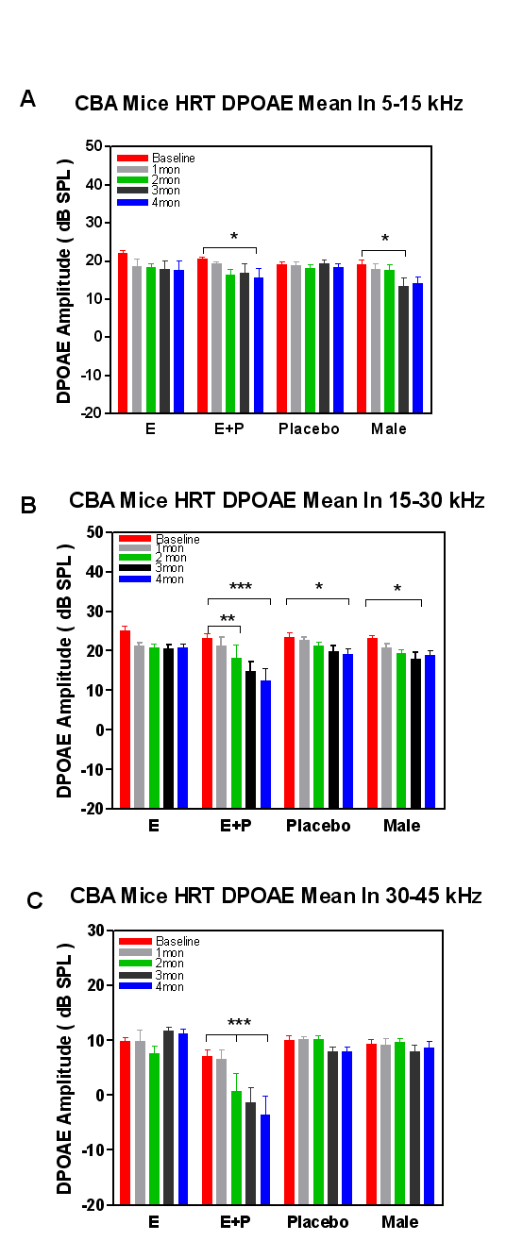
HRT Affects the Outer Hair Cells in Aging Female CBA Mice:
Otoacoustic Emissions Amplitudes Decline during HRT Treatments
From Price, Frisina et al., Hear. Res, 252, 2009

Slide 17
Summary – HRT - Mouse
Pure tone ABR thresholds: the E+P group had greater threshold increases than the E group and NHRT group, for middle and high frequencies
The E+P group presented lower DPOAE amplitudes than the E group and NHRT group over the 4-month experiment, especially at middle and high frequencies
These findings suggest, like our clinical studies, that the presence of Progesterone as a component of HRT causes poorer hearing abilities in aging CBA mice, affecting the outer hair cells and peripheral auditory system

Slide 18
Aldosterone & Presbycusis:
Sodium/Potassium Regulation
Sodium (Na+) and potassium (K+)very important in inner ear, & neural function
Aldosterone – main hormone for regulation of K+ and Na+
Trune: Aldosterone – treatment for sudden/autoimmune hearing loss in mice
Aldosterone tends to decline with age
In aged human subjects, we measured Aldosterone levels in blood, and measured hearing abilities, peripheral and central

Slide 19
Presbycusic Subjects Have Lower Serum Aldosterone Levels
From Tadros, Frisina et al., Hearing Res., 2005

Slide 20
Aldosterone Levels Correlate with Good Hearing in Aging
r² = 0.32, p <0.0001
r² = 0.23, p = 0.0007
From Tadros, Frisina et al., Hearing Res., 2005

Slide 21
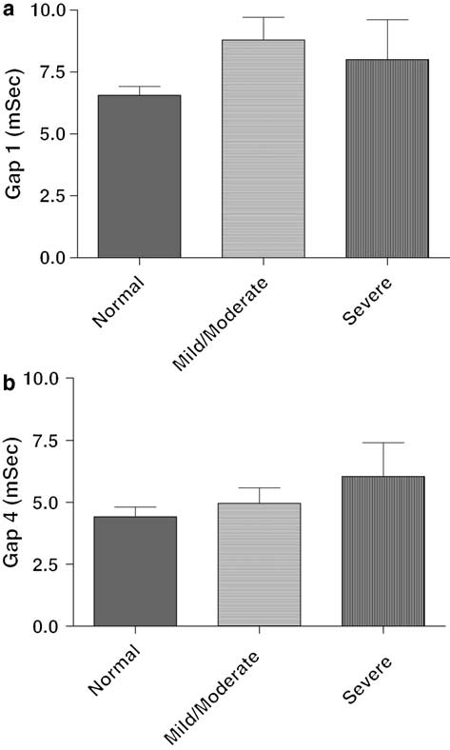
Aldosterone can affect Auditory Temporal Processing
Supra-threshold Gap Detection thresholds are longer for old subjects with lower serum aldosterone levels
- For both low (1 kHz) and high (4 kHz) speech frequencies
From Tadros, Frisina et al., Hearing Res., 2005

Slide 22
Conclusion: Aldosterone Protective for Presbycusis?
There is a significant difference in serum aldosterone levels for aged subjects between normal hearing listeners and subjects with hearing loss.
Aldosterone levels are highly correlated with pure-tone thresholds, temporal processing (peripheral hearing) and hearing in noise test (HINT) scores (central auditory brainstem processing).
Serum aldosterone may have a protective effect on hearing in old age, both peripherally and centrally.

Slide 23
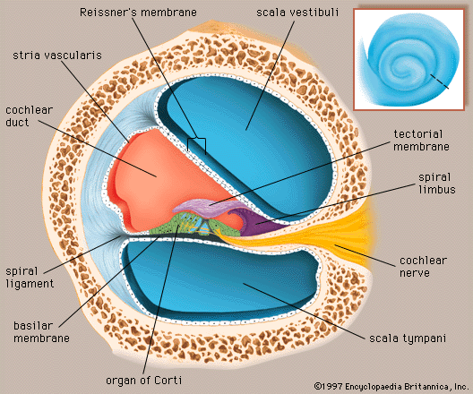
Preventing Presbycusis – Preserve Hair Cells, Spiral Ganglion Neurons, and Stria Vascularis during Aging
http://cache.eb.com/eb/image?id=14301&rendTypeId=4
Notes:
The inner ear is fluid filled, and contains two fluids of different ion concentrations such that there is an electrochemical potential. This potential allows ions to flow into the sensory cells of the inner ear when vibrations occur on the basilar membrane.

Slide 24
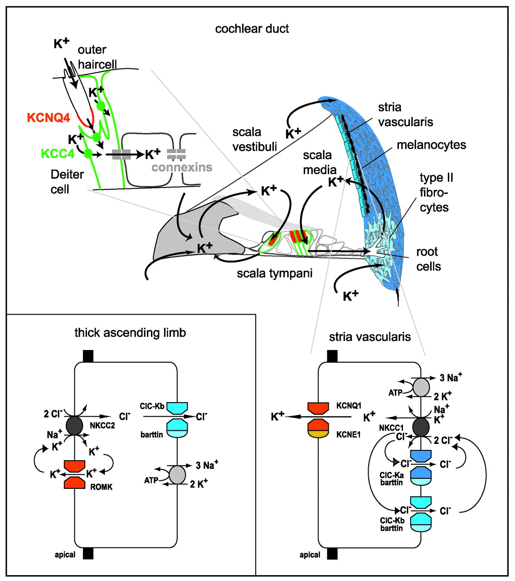

Ion Transport pathways in the inner ear and in the kidney
Hübner C A , and Jentsch T J Hum. Mol. Genet. 2002;11:2435-2445
©2002 by Oxford University Press
Notes:
Figure 1. Transport pathways in the inner ear and in the kidney (thick ascending limb). The main diagram shows a cochlear duct, highlighting the proposed K+ ion recycling pathways. Hearing depends on a high K+ concentration (150 mm) bathing the apical membranes of sensory hair cells. During sound stimulation, K+ enters the hair cells via apical mechanosensitive cation channels. K+ exits from outer hair cells, probably through KCNQ4 K+ channels. K+ is then taken up via the K–Cl co-transporter KCC4 by supporting Deiters cells (shown in detail at top left). K+ passes fibrocytes of the lateral wall through gap junctions to the stria vascularis, where it is pumped into the endolymph. In strial marginal cells (magnified below), basolateral NKCC1 raises intracellular K+ concentration. Parallel ClC-Ka/barttin and ClC-Kb/barttin channels recycle Cl−. K+ exits through apical channels containing KCNQ1 subunits and KCNE1 subunits. Loss of KCNQ1, KCNE1, NKCC1 or barttin causes deafness in humans and mice. Neither loss of ClC-Ka nor of ClC-Kb alone entails deafness. In cells of the renal thick ascending limb (inset), apical NKCC2 co-transporters driving Cl− uptake require ROMK to recycle K+. Cl− exits through channels containing ClC-Kb α subunits and barttin β subunits. Mutations in all four genes cause Bartter syndrome.

Slide 25
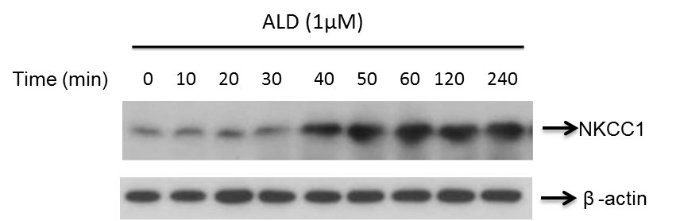
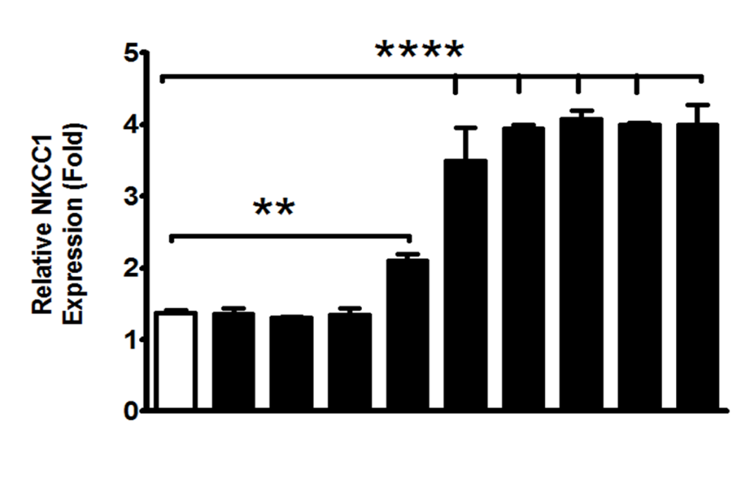
Aldosterone can up-regulate NKCC1 ion channels found in the cochlea

Slide 26
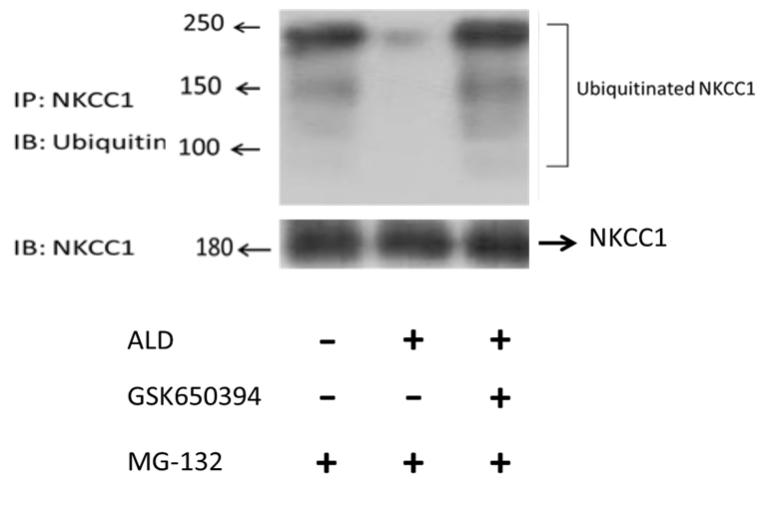
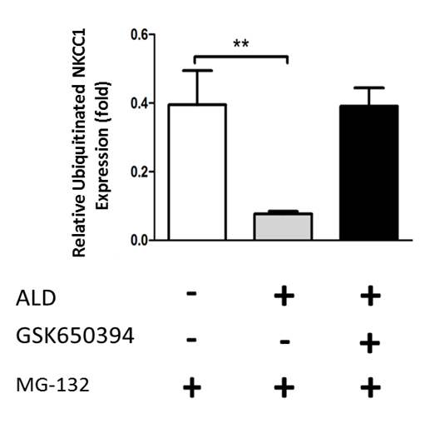
Cochlear Ion Pumps: Aldosterone increases NKCC1 by blocking post-translational degradation
ALD – aldosterone – hormone regulates Na/K Channels
MG-132 – Proteasome Inhibitor
Proteasome – Breaks down proteins
GSK650394 – Inhibits SGK1 molecular pathway

Slide 27
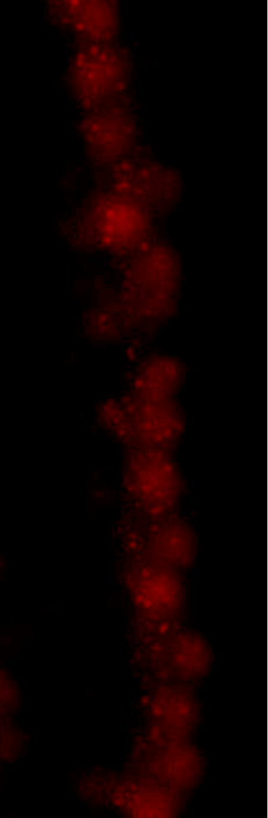
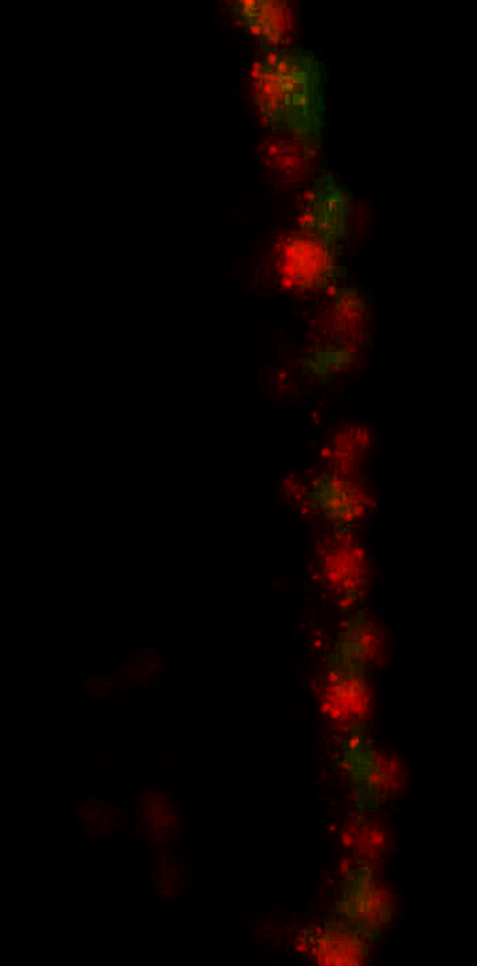
Cochlear Biomarkers for Presbycusis: Ribbon Synapse Protein Expression gives Readout of Hair Cell/Auditory Nerve Synaptic Function -
Antibody Protein Staining
Red: Anti-CtBP2
Green: Anti-GluR2
Blue: Dapi, Nuclei

Slide 28
Pharmacology of Preventing Noise Damage- Antioxidants
Administration of antioxidants in animal models, mostly rodents, show dramatic reduction in noise-induced hearing loss
Vitamins A, C, E, Mg, (LePrell, Miller); NAC (Crandell, Kopke) have shown success
Unfortunately, clinical trials in humans, mostly with military subject populations, have failed
Could be due to species differences, dosages, timing, age of subjects (3 month old mouse same as 21 year old human?)

Slide 29
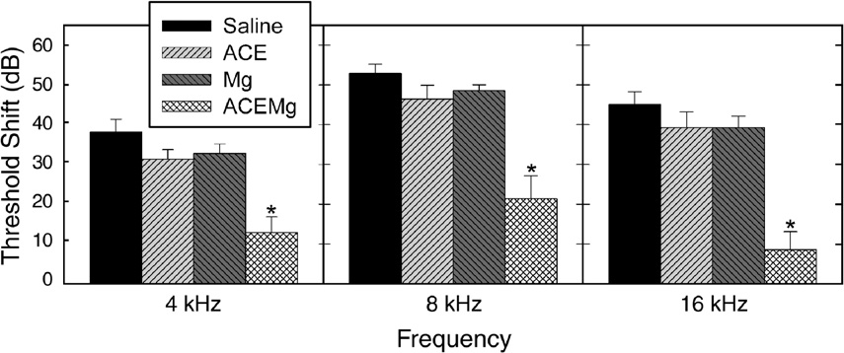
Pharmacology of Preventing Noise Damage- Antioxidants
LePrell et al. 2007; Guinea pigs; octave-band noise, centered at
4 kHz, 120 dB SPL, 5 hr; ABR thresholds

Slide 30
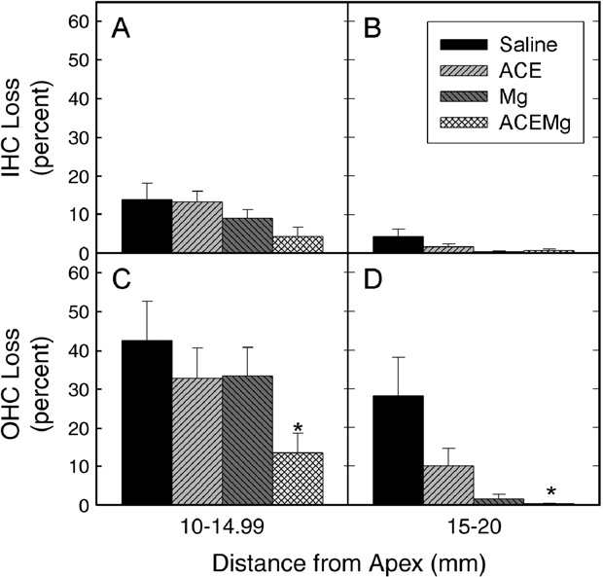
Pharmacology of Preventing Noise Damage- Antioxidants
LePrell et al. 2007; Guinea pigs; octave-band noise, centered at 4 kHz, 120 dB SPL, 5 hr; hair cell counts

Slide 31
Future Directions
Additional breakthrough advances might well come from biomedical engineering accomplishments in the areas of local drug delivery to the inner ear
Advantages here will include better control of the concentrations of the delivered agents, ability to control volumes and infusion rates more precisely, programmability, and avoidance of digestion/breakdown/variable-serum-level problems of oral administration
Very little research is being funded currently on microsystems drug delivery to the inner ear
As progress is made, pumps will become better and smaller allowing for otolaryngologists to implant (refillable, programmable, wireless power supplies…) inner ear micropumps with outpatient procedures no more invasive, than perhaps implanting a tube in a child’s tympanic membrane to treat chronic middle ear infections.

Slide 32
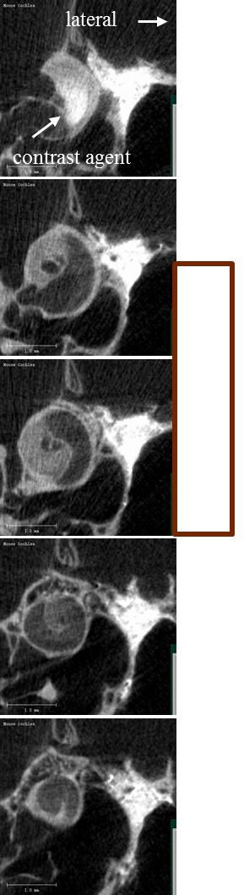
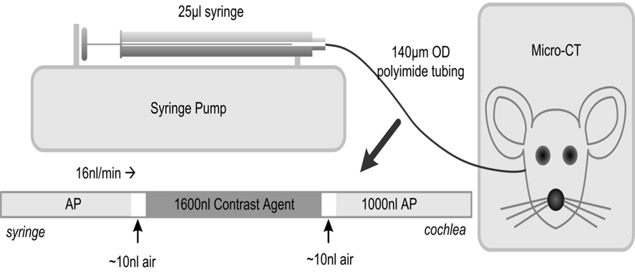
Microsystems: Research Highlights
Drug Delivery to the Inner Ear - Cochlea
Create novel, drug delivery “smart” micro-pumps for delivery of bio-therapeutic agents to the inner ear
Start by preventing noise-damage, age-linked hearing loss, side effects of chemotherapeutic agents and anti-biotics
Mouse models very advantageous for genetics, but very difficult due to the small size of the mouse inner ear: 600 nL
Can image the infusion of agents in the mouse inner ear in real-time using micro-CT biomedical imaging technologies

Slide 33

Chronic Noise Exposure/Unexpected Impulse Blast: A Biomedical Protective System
acoustic / kinetic sensor
algorithm / threshold
therapeutic delivery to cochlea
data storage / integration

Slide 34
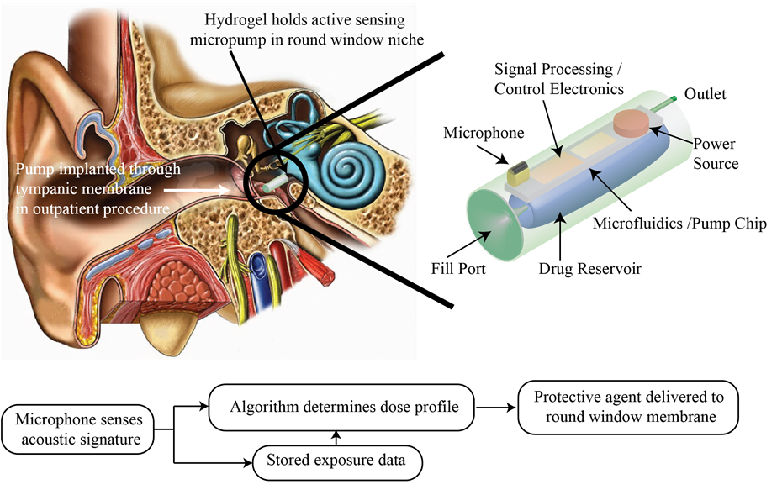
Microsystems: Research Highlights
Drug Delivery to the Inner Ear – Prevent Noise Damage
Create novel, drug delivery “smart” micro-pumps for delivery of bio-therapeutic agents to the inner ear

Slide 35



Work Supported by NIH, USA:
National Institute on Aging, National Institute on Deafness & Communication Disorders

Slide 36
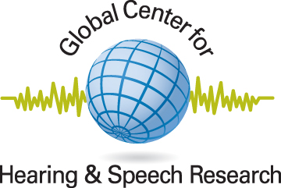
Global Ctr. Hearing/Deafness
/Speech Research Group
Dr. Bo Ding – Molecular Biology of Hearing Loss
Dr. Ann Eddins – Research Audiology, Neurophysiology
Dr. David Eddins -Psychoacoustics, Speech Processing
Dr. Robert Frisina, Sr. – Speech Perception, PET, Audiology
Dr. Robert Frisina, Jr. – BME Neuroengineering, Anatomy
Dr. Joseph Walton –Auditory Neurophysiology
Dr. Xiaoxia Zhu – Histology, Neurophysiology: ABRs and Emissions
International Collaborators
Dr. David Borkholder, RIT - Micro-Systems Engineering
Dr. Barbara Canlon, Karolinska Inst. Stockholm – Neuroscience, Hormonal Effects on Hearing
Dr. Mary D’Souza, URMC – Molecular Biology, Gene Arrays
Dr. Rick Friedman, UCLA, CA - Human Genetics
Dr. Dina Newman, RIT – Genetics
Dr. Sherif Tadros, U. W. Australia - Genetics, Bioinformatics

Slide 37

Questions?

